Slide 1

E-Filing study Modernizing the E-filing experience and infrastructure
Prepared by 18F | February 2, 2017
In partnership with the Federal Election Commission

Slide 2
Presentation structure
1
2
3
4
A. filer experience
Goals and approach
What we found
B. scalable infrastructure
How to move forward
Questions
Notes:
This presentation is meant to touch on parts of the report, but only touch, and only parts. There is far more detail in the report: this is meant to give a sneak peek at a few of the big takeaways.

Slide 3
Background and goals

Slide 4
How can we modernize the e-filing system to get better quality data, be responsive to user needs, and handle increasing volumes of data?
Notes:
We were tasked with 2 main goals in the e-filing system: to understand the filer’s experience and to understand the technical underpinnings.
Relevant information we sought:
How do filers currently use e-filing software? What aspects of their process are particularly cumbersome or error prone? What barriers drive them crazy? What short-cuts, workarounds, and help do they employ? What’s working well?
E-filing analysts (internal to the FEC): how does the form and format of e-filing negatively and positively affect the Electronic Filing Office and RAD analysts’ workflow?
How do different kinds of vendors interact with their filers and the FEC? How might software vendors be impacted by changes to the FEC’s filing process?
We also interviewed FEC technologists and contractors on the current system to ask them; What is going well? What are the pain points?

Slide 5
Our approach
Notes:
So, how’d we do it?

Slide 6
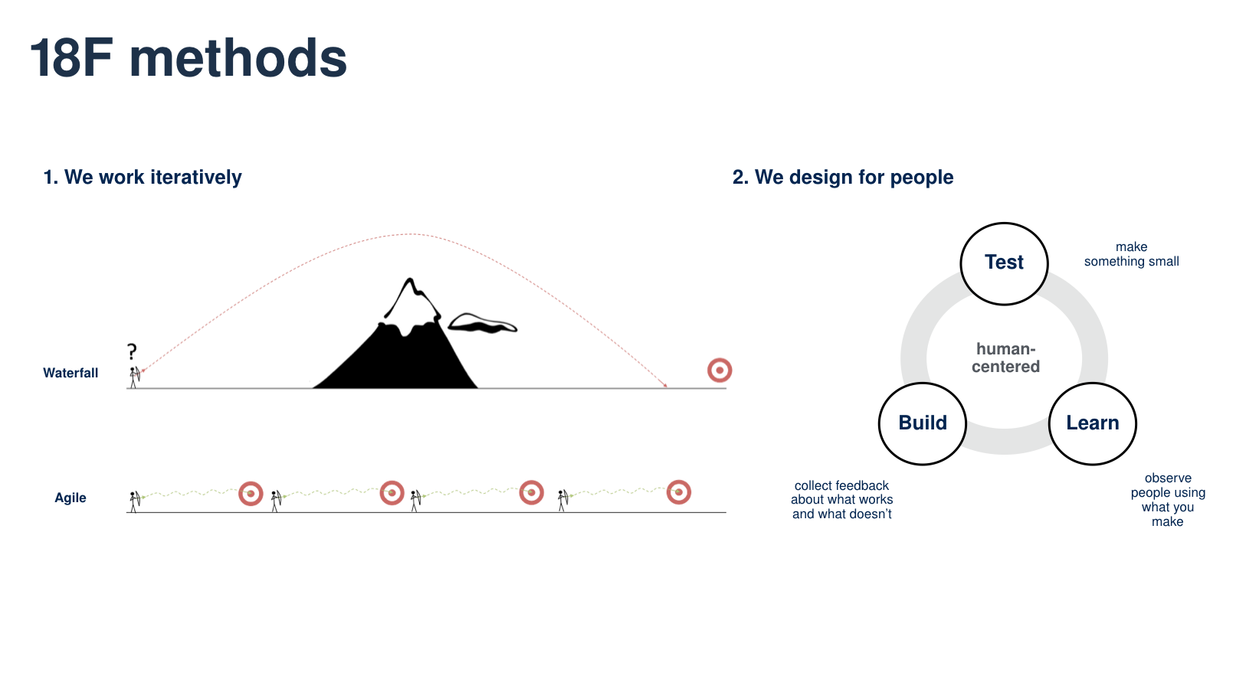
Notes:
There are two aspects of our research that make our approach something different: we keep the focus on the user, and we focus on small bets, quickly validated.
We believe that through iteration and keeping users at the center of the process, the best solutions emerge over time, through experimentation. So we learn, build, and test to see if we were right.
Quick example of how this played out:
Through interviews, we learned that folks used exports from bank accounts, payroll systems, and membership databases to fill in the data, and that only a few experts knew about and used the import feature in FECFile.
We quickly designed a prototype that attempted to make it clearer how to initiate an import and attempted to simplify the import flow. We then took this simple prototype to users to see if they could figure out how to make it work. From these tests, we learned what did and didn’t work, which informed our recommendations. If you want to check out what folks struggled with, or what the import feature we designed looked like, hang around after the presentation, we’ll show you more.

Slide 7
Research activities
Goal-setting workshop with FEC
Contextual interviews and observations
Prototyping and prototype testing
Survey distributed to all current E-filers
Notes:
So that’s the approach in general, here’s what it looked like, reduced to bullets.
Worked with the team at the FEC to figure out what the goals were, and who to talk to
Held “contextual interviews”, which is basically a fancy word for “watch people work, take notes and ask questions”
From those interviews, put together prototypes which we then tested
And then, to go broader on one specific question, we surveyed the user base, more on that later

Slide 8
We talked to
12 Filers of varying experience (+10)
12 Experts in various roles within the FEC (+9)
5 Commercial campaign finance software vendors
3 Data consumers (e.g., journalists, academics)
533 Survey respondents (filers)
Notes:
Here’s a list of folks we talked to.
You are probably tired of hearing us say this, but our research process focuses on going deep with a smaller number of subjects than shallow with many.
Most of the filers we talked to multiple times, first learning how they interact with the e-filing process as it stands, later trying out design concepts and prototypes.
There are times when it’s good to go broad, and we found occasion to here with our survey. I’ll let Melissa tell you more about that.
The numbers from the early study in 2015 are in parentheses.

Slide 9
What we found (at a high level)
Notes:
There’s a lot more in our report, this presentation just hits some of the highlights.
I’m going to breeze through some of the findings from our study, then let Melissa & Lindsay dig into some of the details.

Slide 10
Helping filers complete forms correctly will improve data quality, filers’ experience, and the experience for data users both inside and outside the FEC.
A. Filer experience
Notes:
Many data quality issues can be traced to confusing elements in the filers’ experience. When filers make mistakes or misunderstand form fields, their errors have repercussions through the entire data ecosystem.
Right now, RAD analysts do a fantastic job of helping guide people through the process (people love their analysts), but people have to know to call, or know where to look on the website, which the generally don’t.
If FEC focuses it’s efforts in a user centered way on the filer, it will have cascading benefits throughout the entire data ecosystem, from less calls to RAD, cleaner reports, less amendments, which means less overall data that needs to be processed and stored, and ultimately less difficult to analyze data both internally and externally.

Slide 11
Existing infrastructure and processes meet the current demand.
B. Scalable infrastructure
But this will likely be increasingly difficult in the future…
...without continued evolution.
Notes:
The FEC’s current filing infrastructure and processes are just capable of meeting the demand for filers and the public.
While the filers and commercial software vendors we spoke to had complaints about the specific tools and operations, we heard little to nothing about the filing infrastructure. We heard many compliments for the folks in e-filing, (some including Ken by name).
This is good news.
That said, the transaction data that the filing community is submitting to the FEC is growing exponentially, and the increasing data volume is already straining the processes that worked in the past (separate processes for large filers, software faltering when used on the largest campaigns that the team has had to fire-fight. These problems will only intensify. This is less good news.
The best news, though, is that the tech team at the FEC is already, and has been, in the process of taking steps that will help evolve the Agency to operate in the new environment. These include such initiatives as using webforms for data intake, using OCR to speed the processing of paper-based data, and crucially, migrating to the cloud. If these are fostered, the Agency can not only continue to keep pace with the changes, but set an example for other government agencies.

Slide 12
What we found deep dive: Filer experience

Slide 13
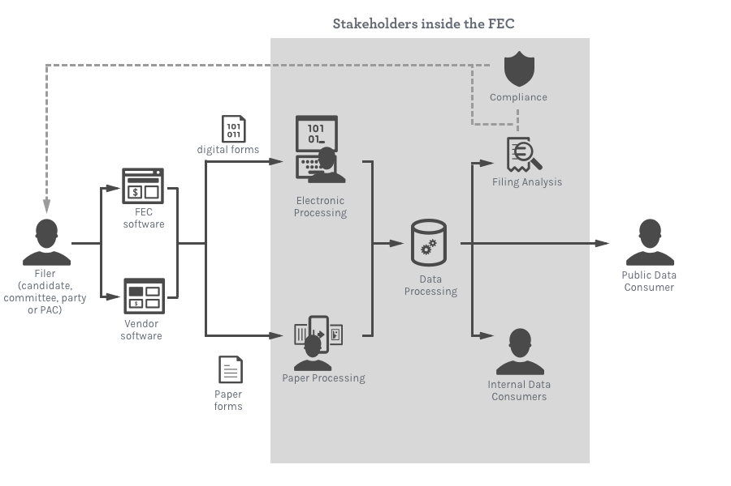
The flow of campaign finance information throughout the E-filing system.
Notes:
We are going to go into some more detailed information flow diagrams later on, but I wanted to start at this high-level. This graphic shows the flow of campaign finance data throughout the efiling system.
Committees, candidates, parties, and PACs accept donations and spend money to fund a campaign.
Each committee or committee’s designee tracks the flow of funds and then reports this information to the FEC using paper forms, vendor software, or the FEC’s filing software, FECFile.
The data in these reports passes through the Electronic Filing Office (EFO) and then moves on to the Reports Analysis Division (RAD), where algorithms and analysts review the report and check for errors and discrepancies.
At the same time that the report is being reviewed, it is made publicly available so data consumers (including journalists and the general public) can access it through the FEC’s website, API, and bulk data offerings.
When filers make mistakes or misunderstand form fields, their errors have repercussions through the entire data ecosystem: data entry errors and omissions create a greater processing burden on the EFO and heavier workload for FEC Personnel, both of which can lead to delays in data becoming publicly available. Ultimately, errors impact the timeliness and accuracy of data available to the public.
But I want to emphasize that every filer we heard from wants accurate and complete reports. The idea behind many of our recommendations in this section is to empower filers to file the way they want to file.
The way to do that is to by making it easier for filers to use the e-filing software.

Slide 14
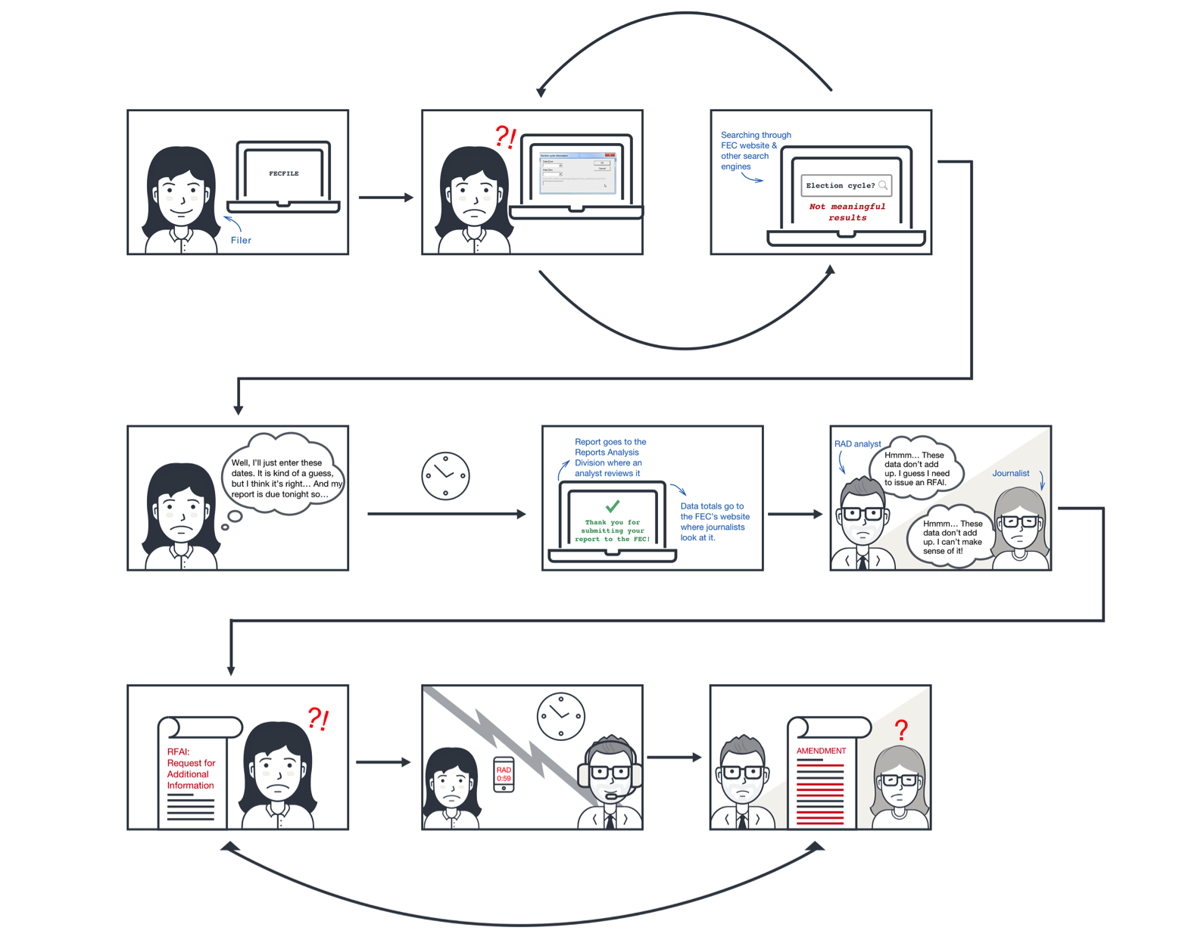
A short story about the filer experience
Notes:
But before I get into those recommendations, I am going to walk you through a story that will hopefully bring that diagram to life.
Here is one high-level scenario that follows a filer’s experience through the reporting process.

Slide 15
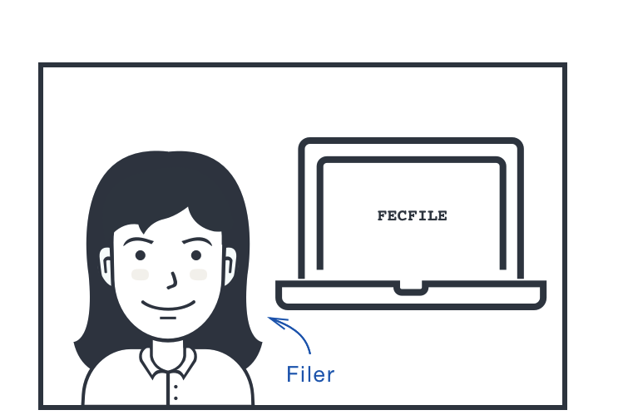
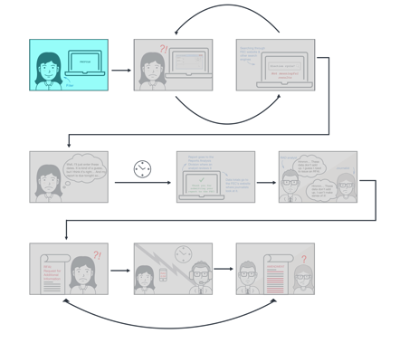
Notes:
Francine filer is helping out a friend who’s running for office. Although it is late in the evening on the day the report is due, she has read the guidance on the FEC’s website. She opens FECfile with the idea of filing a report for her friend.

Slide 16
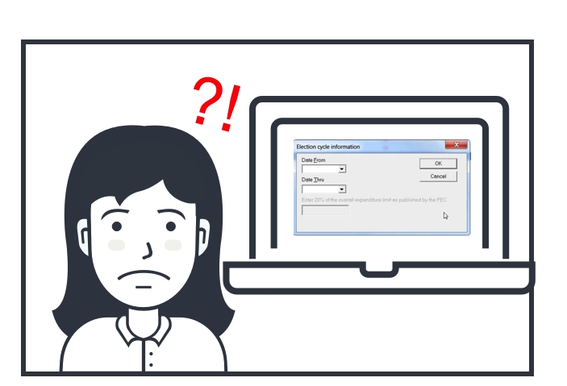
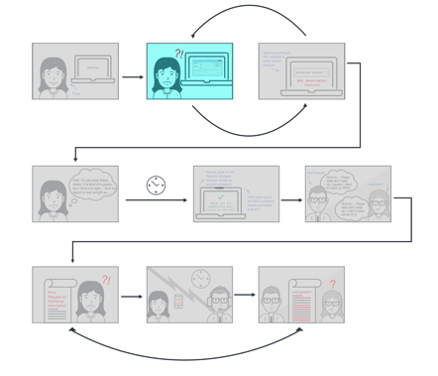
Notes:
The system asks her to enter the dates of election cycle but she is confused. Is that the same thing as the dates of the reporting period? She is not sure what “election cycle” means.

Slide 17
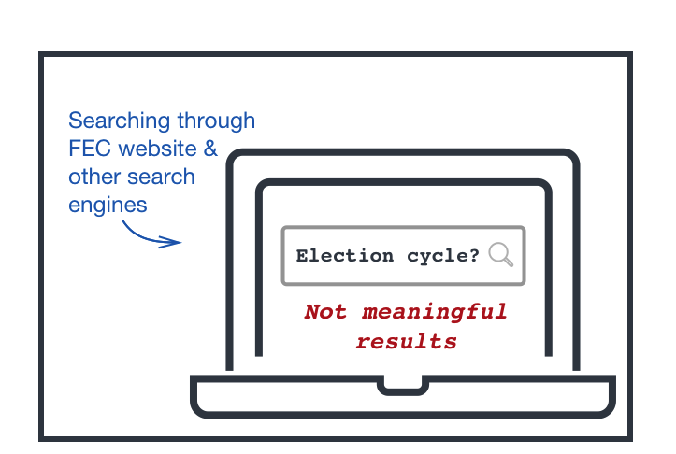
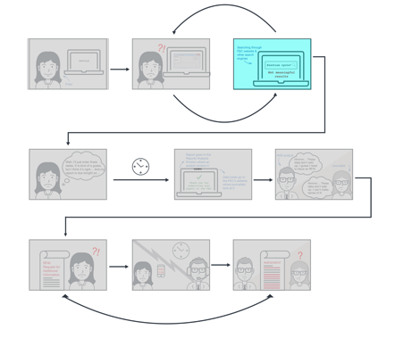
Notes:
She turns to Google for help, but she cannot find the information she needs in order to be sure that she understands what dates to input.

Slide 18
Filers often have trouble with election cycles.
If the election cycle is incorrect, the filer will get a letter because their columns A and B cycle-to-date totals will be wrong.
One analyst estimated that nearly every time column B is wrong on federal candidate committee reports, it is because the election cycle is incorrect.

Slide 19
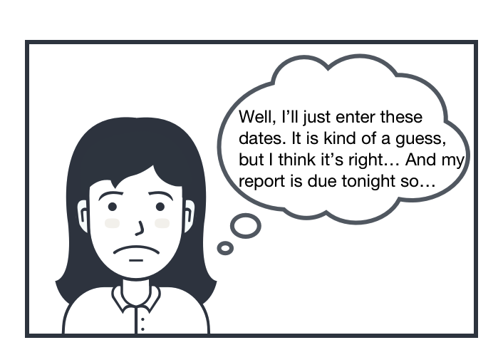
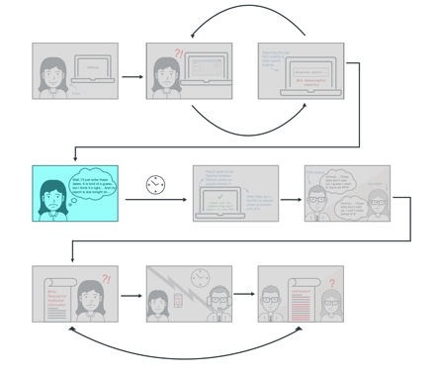
Notes:
Because it is after business hours, Francine cannot call the FEC for help, and she is afraid of what will happen if her report is late.

Slide 20
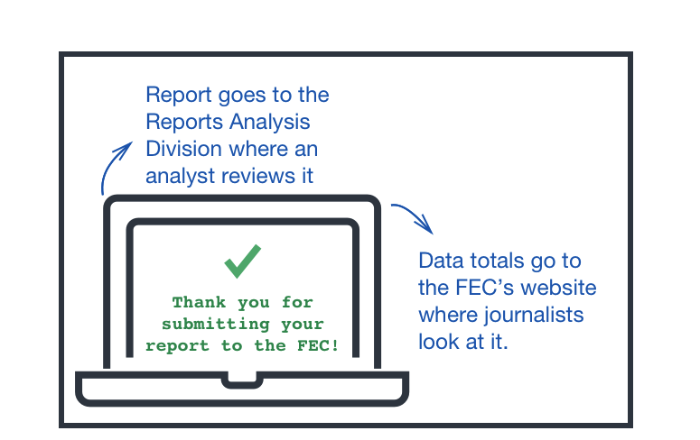
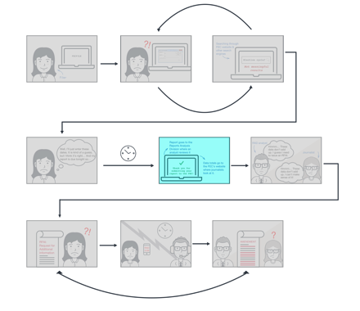
Notes:
Francine makes her best guess that “election cycle” is the start and end dates for the reporting period. Although this is incorrect, the system accepts this answer, so Francine is able to submit her report on time.

Slide 21
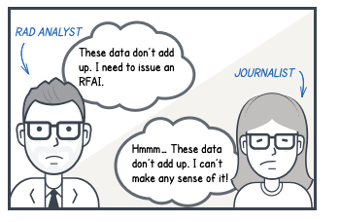
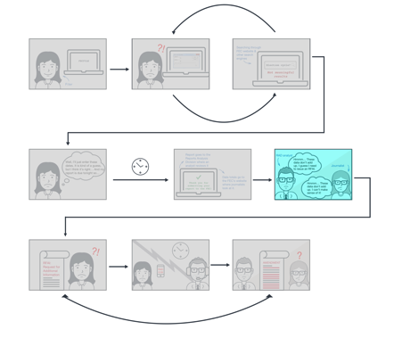
Notes:
The data in Francine’s report becomes publicly available on the FEC’s website, but because the election cycle dates are not right, the cycle-to-date totals are off, which make the data difficult for many journalists to interpret. At the same time, Francine’s report goes to the Reports Analysis Division where an analyst finds the error and sends Francine a Request for Additional Information (RFAI).

Slide 22
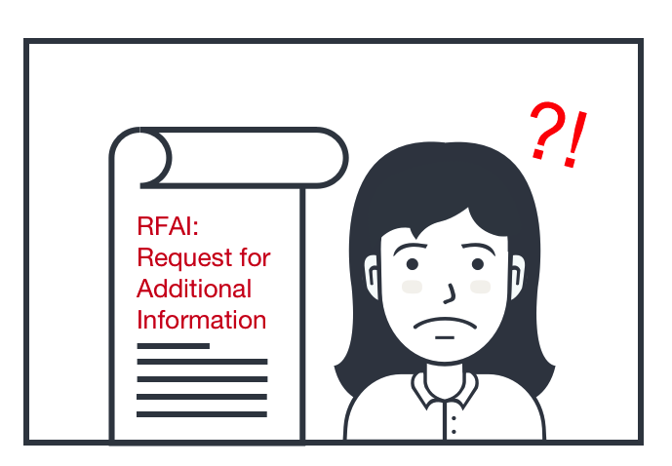
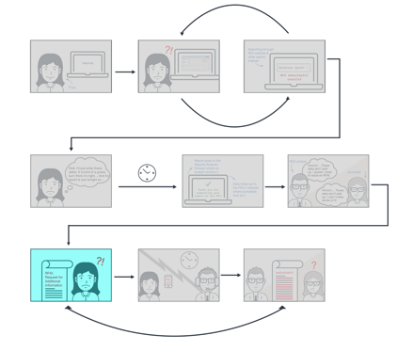
Notes:
A little while later, Francine receives the RFAI letter in the mail. The letter is official looking, which she finds intimidating. She is not sure what the letter is asking her to do, and she is afraid of the consequences.

Slide 23
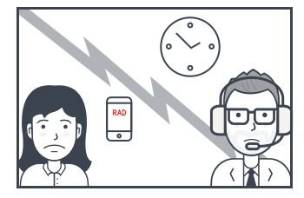
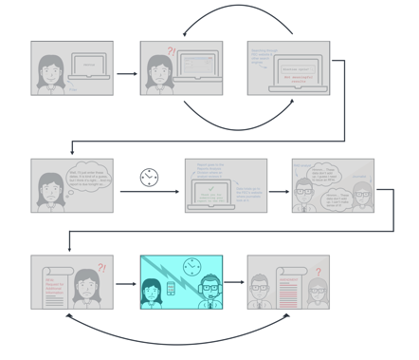
Notes:
Francine calls RAD for help resolving the issue. An analyst patiently walks her through how to resolve the issue, which includes filing report amendments. This conversation takes an hour.

Slide 24
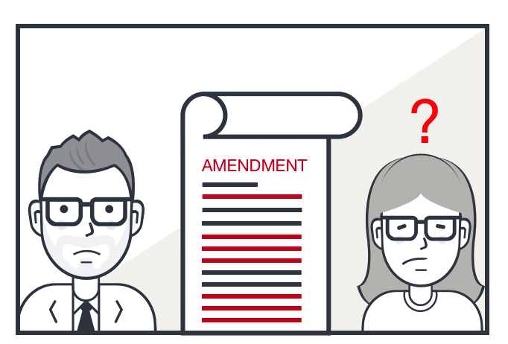
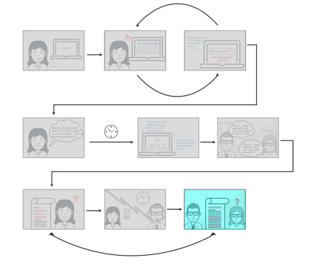
Notes:
The data in the amendments becomes public on the FEC’s website where our journalist struggles to make sense of them and how they tie back to previous reports. At the same time, a RAD analyst reviews the amendments, looking again for errors, which, if found, will repeat the cycle all over again.

Slide 25




Filer experience | Recommendations
Re-architect current data validation
Provide an export capability
Improve FECFile’s usability
Offer an open source, web-based version of FECFile
Notes:
The idea behind many of our recommendations in this section is to empower filers to file the way they want to file.
The way to do that is to by making it easier for filers to use e-filing software.
Because we have limited time, I am briefly going to introduce these top two ideas before diving into the bottom two in a bit more detail.

Slide 26
Filer experience | Recommendations
Re-architect current data validation
Provide an export capability
Improve FECFile’s usability
Offer an open source, web-based version of FECFile
Notes:
VALIDATION
More feedback about data quality as filers are completing forms would improve the filer experience. In our report, we recommend changes to the current validation rules to help filers fix errors before they reach the FEC.
We also recommend helping non-FECfile users and commercial software vendors by changing the way validation happens as a part of the modules the vendors use.
(FECCheck already runs as part of the submission process for FECFile users, but FECCheck before submission is optional for vendors. To mitigate the effects of omissions and errors in the short term, the module that sends information from vendors to the FEC, FECLoad could be modified to run validation.)

Slide 27
Filer experience | Recommendations
Re-architect current data validation
Provide an export capability
Improve FECFile’s usability
Offer an open source, web-based version of FECFile
Notes:
EXPORT
FECFile does not currently offer a way for users to export data. Adding this capability would help filers as well as the FEC Audit Division, and commercial software vendors.
Filers can sometimes lose their reports, and without the ability to export from FECFile, they have to “rebuild” their entire database. Were their data exportable, they could simply import it back into FECfile, which would prevent rekeying errors and save time. In addition, filers could use an export feature to sort and manipulate their data in a spreadsheet, which would help them find and resolve errors and amend reports.
The need to manipulate report data in spreadsheet form is also shared by the FEC’s Audit Division, and auditors have asked for an export capability in the past.
An export capability would help vendors easily transition FECFile users to their software by enabling them to download data from FECfile and upload it to the vendor’s system, rather than rekeying it.
Finally, adding an export capability is a milestone on the way toward transitioning users from a desktop FECfile to a web-based system, as the FEC will need to have a plan in place for getting data out of FECfile and into the new system.
Now I am going to go into a bit more detail with these last two things...

Slide 28
Filer experience | Recommendations
Re-architect current data validation
Provide an export capability
Improve FECFile’s usability
Offer an open source, web-based version of FECFile
Notes:
...starting with improving FECfile’s usability.

Slide 29
59% of entities filing electronically use FECfile.
Only 17% of the 402 FECFile users in our survey identified themselves as compliance professionals.
Notes:
While we heard from many compliance professionals who use FECfile, FECFile is the software used by most novice filers, like Francine in our story.
We will talk more about the survey later, but here are a few things we learned.
Most FECfile users are not compliance professionals. They file for a single candidate, committee, party, or PAC and have reports that typically include small numbers of transactions.
Many FECfile users represent the small “mom and pop” committees that help the FEC live up to its ideal that “anyone can run for office” and who really rely on FECFile being easy to use.

Slide 30
One of the most powerful ways to make the filing process more intuitive is to make the FECFile software more usable.
Notes:
We found that filers, like Francine in our story often want to report correctly, but struggle to do so.
We know filers are want to get it right, but it is complicated. Understanding campaign finance law, rules, regulations, and policies is not intuitive, even for seasoned professionals.
We found many opportunities to design changes to FECfile that would help simplify compliance without touching law, regulation, or policy. And some that do.
Empowering filers to report the way they intend to means making FECFile as intuitive as possible.

Slide 31
The flow of campaign finance information throughout the efiling system.
Notes:
Making FECfile intuitive will help filers file the way they want to – accurately and completely. This will in turn alleviate the processing burden and workload for the EFO and FEC staff, but perhaps more importantly, it will improve the timeliness and the accuracy of data for the public data consumer.
We include a number of detailed recommendations on areas to focus in our report, and we will come back around to how to take the next step in the final section of this presentation.

Slide 32
Filer experience | Recommendations
Re-architect current data validation
Provide an export capability
Improve FECFile’s usability
Offer an open source, web-based version of FECFile
Notes:
Now I am going to talk about an open source web-based version of FECfile from the filer experience perspective before I hand it off to Lindsay who will talk about it from the technical perspective.

Slide 33
The fact that FECFile is a desktop application constrains filers’ workflow.
Filers need open source software that is operating system independent.
Notes:
Nearly everyone we talked to liked the idea of a web-based FECfile.
The fact that FECFile is a desktop application constrains filers’ workflow.
Filers need a system that is operating system independent.

Slide 34
“I am a MacBook Air user, so I have to go and find the PC laptop in the office that stores FECfile. If I forget that a report is due and I'm at home, I have to go to the office, find the laptop, and fill out the report.”
“I live in constant terror of a computer crashed around filing time, even to the point of being afraid to make updates on my computer in the event that I may lose filing information that I have already entered. A cloud-based storage system would provide so much relief from those concerns.”
“I travel extensively and sometimes must complete the report from locations other than my office and computers other than my regular workstation. As a result, I must remember to download the data file to a USB drive and take with me to use. Then I must remember where my most recent data is stored. A web based system would eliminate this problem.”
“[a web-based system] would absolutely be helpful! There are two of us that work on the FEC filings and, currently, I have to wait until I can use the other person's laptop (where the FECFile software is stored) in order to enter the data needed for a filing.”
Notes:
Here are just a few quotes from users about some of the challenges with the current desktop software.
FECFile is currently only supported on PC, but many filers want to be able to work on reports using multiple computers, including both Windows and Mac OS. Filers who primarily use Macs must find secondary computers, use a windows emulator, or seek out PC users who can file on their behalf.
Filers also expressed a desire for cloud-based storage, access to FECFile away from the office, and the ability to collaborate with colleagues in other places to complete reporting tasks.
One way to address these problems is to move the software, which is stored locally on users’ computers, to a web application,

Slide 35
We wanted to let all current E-filers tell us their thoughts about a web-based FECFile.
We sent an anonymous survey to 8,906 unique email addresses. We received 533 responses.

Slide 36
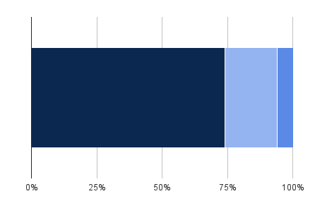
“If a web-based version of FECfile were available, would you use it?”
Tell me more
Yes
No
Percent of respondents
Notes:
The majority of respondents (74%) said they would use a web-based version of FECFile if it were available. For the folks who are using FECFile now,
83% said they would use it
6% of FECFile users said they would not; (those who commented cited either perceiving no benefit toward web based software or citing performance concerns of web based software;
11% said they’d need more information, (we asked what information they would need, we got 38 substantive responses:
14 wanted more information about security and privacy
8 want to know more about the usability of the new system, with several folks calling out whether it would give them the ability to import their data.
6 mentioned they would need to know more about a web-based system's ease of access and compatibility with their existing systems/way of working
2 had Qs about performance
5 had questions about how the new system would compare to FECfile, expressed fear of changes breaking something that is currently working, and potential risks
2 wanted to know about how data are backed up
1 need to have my IT person review
1 Will there be access controls?
[Of the folks who said they would not use a web-based FECFile, some commented that they didn’t believe a web-based FECfile would help them because: they perceive web-based systems as having slower performance; they only work on filings while they are at their desk; or they primarily use vendor software that is already web-based.]
About 17% of all survey respondents said they would need more information, mostly about how their data were secured and stored, before they could decide.
In general, the people who said they would use a web-based FECFile are already FECFile users, report small numbers of transactions, and are less likely to be compliance professionals.

Slide 37
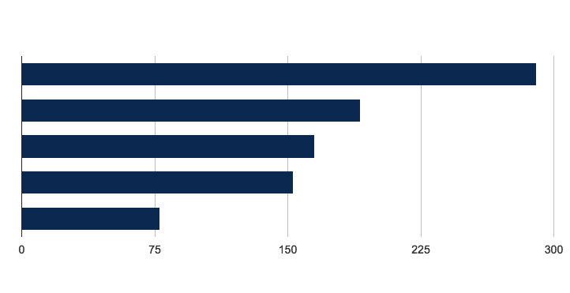
“Of the following capabilities we hope this change will accomplish, which are you most excited about?”
Real-time collaboration on reports
Access to reports in progress from multiple devices
Data backed up on central servers
Data backed up in the cloud
Mac compatibility
Number of responses
Notes:
We asked folks to tell us which of these capabilities they are you most excited about, and this is what they told us.
Now I am going to hand it off to Lindsay who is going to talk to you about some of our findings with regards to technical infrastructure.

Slide 38
What we found deep dive: Scalable Infrastructure
Notes:
In parallel to all of that research on improving the filer experience and data quality, we also looked at how to modernize efiling infrastructure

Slide 39
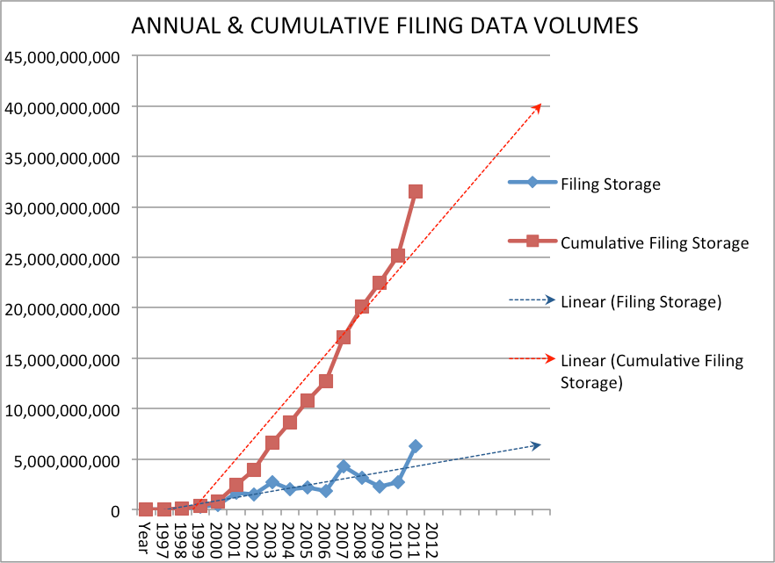
2013 Study projection
Notes:
Here’s the cumulative filing data volumes from the early 2013 study. Pay attention to that red line.

Slide 40
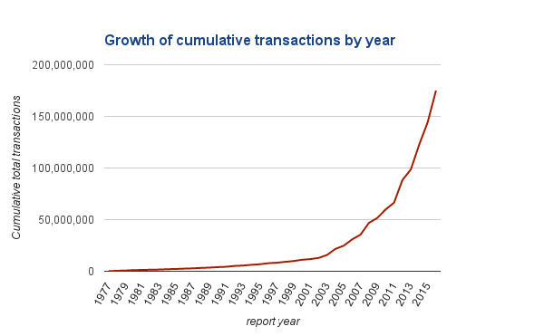
2016 Study (actual data)
Notes:
Here’s a similar red line that shows the number of transactions, but zoomed out to include the time since the 2013 study, and going all the way back to ‘77. What perhaps wasn’t clear at the time of the 2013 study was that the growth is in fact exponential, not linear. Right around that time, you hit what’s known as the knee of the curve.
Great, so it’s increasing a lot. Does it matter if it’s exponential or linear?
Well, as futurist Ray Kurzweil put it: “If I take 30 steps linearly, I get to 30. If I take 30 steps exponentially, I get to a billion.
Not to put too fine a point on it, but the system you build to withstand linear growth is not the system that you build to withstand exponential growth.
Additionally, there are many factors outside the FEC’s control that make this growth even harder to predict.
-----
R-squared for an exponential line of fit is .96 (vs linear which is in the .60s). Granted, the charts on this and the last slide are measuring slightly different things, but we believe the two are highly correlated. Also, the raw transaction data show the same exponential trend.

Slide 41
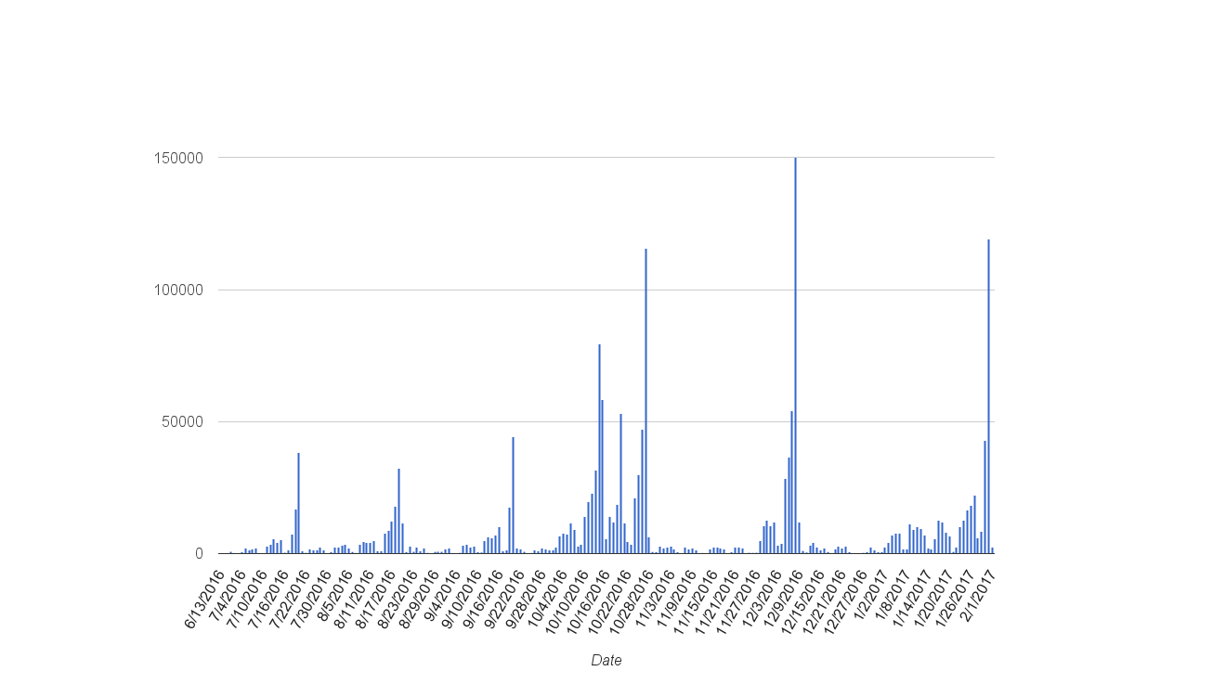
E-filing records per day
Notes:
Not only is the data growing it is growing
We can see this traffic comes with tremendous peaks and valleys. And we know the bulk of the traffic is all going to come in on filing deadlines.
Since you are buying and maintaining your own hardware, you have to purchase the computational and storage capacity for you peak times even though you don’t need all that capacity most of the time.
If you need to add a server because you’re getting spikes in traffic during a filing deadline, adding it is as easy as a few configuration steps, and can be done in minutes to maybe a day. Contrast this with the process to requisition a piece of physical hardware, which can take an agency weeks to months to years.

Slide 42









Impacts
Storage and processing needs will increase at an increasing rate
Analysis more reliant on help from machines
Notes:
What are the impacts of this kind of growth?
Storage and processing needs will increase at an increasing rate
Analysis becomes more dependent on help for machines

Slide 43
Storage and processing needs are likely to increase at an increasing rate
Notes:
Storage and processing are going to continue to grow, and we can expect a lot of growth

Slide 44
Storage and processing needs are likely to increase at an increasing rate
Traffic has peaks and valleys.
Keep moving to the cloud.
Notes:
The rapid growth of records and traffic spikes make moving this system to the cloud a good move.
In the cloud, your server cost is prorated by what you use and you can get more storage as needed.

Slide 45
By Cloud we mean:
Scalability
Don’t worry about hardware
Automated processes
Notes:
By cloud we mean systems
Resources can be easily added or removed, with a simple configuration step
FEC isn’t responsible for patching, hardware security levels etc.
The applications can be automatically redeployed at anytime

Slide 46
Benefits:
Handle more traffic
Don’t worry about hardware
Automating workflow
Pro-rated pricing
Notes:
With scalability, you can handle more traffic
FEC isn’t responsible for patching on an operating system level. Security patches are automatically applied. Choosing a cloud.gov you can also leverage their extensive security contols- we just got a JAB ATO
Automation can relieve staff of the most tedious work so they can focus on things that matter more.
$ With pro-rated pricing, you only pay for what you use. And you would pay a lot less.
You can expect more detail about moving to the cloud in the upcoming 18F-FEC Cloud study
-----------
Note on pricing:
For amazon, about $160 a month for 7TB
Cloud infrastructure also provides cheaper storage for static assets. Amazon's current price structure 7TB would be $161 a month plus up to $0.005 per 1,000 requests. For backups, 7TB could be held in infrequent storage for $88 a month and Glacier, for $28 a month plus requests. See the link for exact details and pricing changes.

Slide 47
Analysis more reliant on help from machines
Optimize data intake for data analysis
Notes:
The second impact is that on this scale
People become more dependent on computer assisted analysis of the data.
That’s not just data pros, that includes website users that need to do sophisticated queries to find answers to seemingly simple questions like finding a particular contributor’s records or how much a candidate raised in an election. We try to abstract that complexity so users don’t have to know the query, but these seemingly simple tools are doing a heavy lift behind the scenes.
Making the system work on paper is somewhat easier because humans are a lot smarter than computers. Humans understand context. However, representations of data that depend heavily on human analysis create a burden that will increase substantially as the amount of data increases.

Slide 48
Optimize data intake for data analysis
Optimize data elements for analysis
Better integrate paper into E-filing process
Notes:
Data intake mechanisms should be tweaked to allow analysis at scale, which is to say,
Think of each form element is a piece of data; it is tied to other pieces of data, both on the form and to entities throughout the campaign finance ecosystem. Currently, there are cases where the form element is best understood by looking at the paper representation of the form. (Memo items are a good example. )
While this study was focused on efiling, the paper processing is tightly integrated and the challenges of these efforts on the system became apparent. Any effort to make the forms more machine interpretable will reduce burden at an increasing rate. What we are talking about here is machine readable paper and better tying paper into the efiling process. (We will talk more about that momentarily)

Slide 49
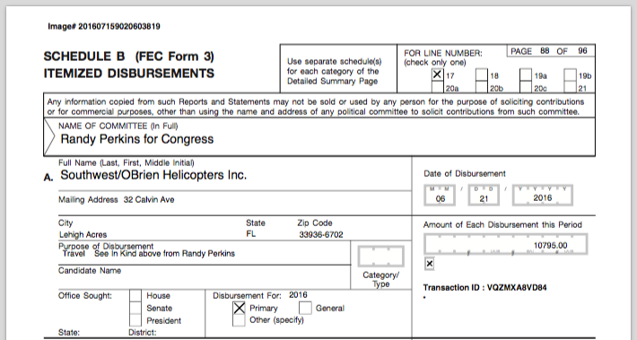
Optimize data elements for analysis
Notes:
So, what do we mean by optimising data for analysis?
Here is an example of a process that works on paper but loses its context and meaning at scale
This disbursement description tells the reader of this document to look at the above disbursement for the purpose
If I have the papers in front of me I can do that easily
http://docquery.fec.gov/cgi-bin/fecimg/?201607159020603819

Slide 50
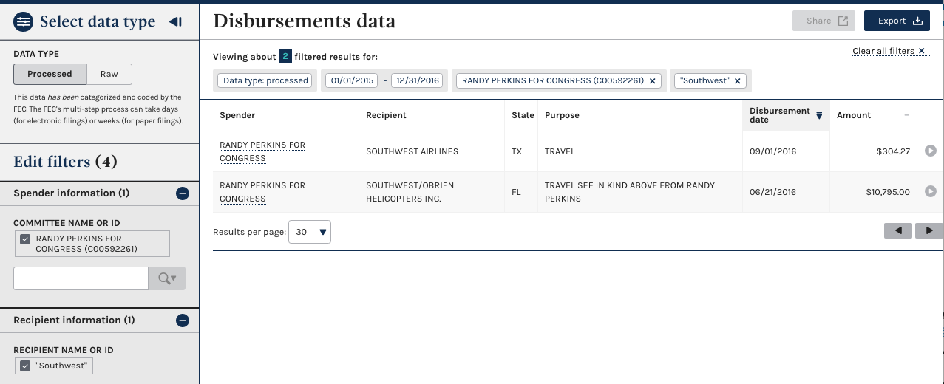
Optimize data elements for analysis
Notes:
We can see that when people start using the data with tools like the website, the transaction that made sense in its original context no longer makes sense.
There is no above.
While a human can go to the image and then page back to the previous page and read the information they are interested in. It’s really hard to train computers to do this. This requires cognitive understanding of language, additional lookup steps and makes it hard to analyze the contents in bulk.
You will be able to look to the report for more details and examples
https://beta.fec.gov/data/disbursements/?two_year_transaction_period=2016&data_type=processed&committee_id=C00592261&recipient_name=Southwest&min_date=01%2F01%2F2015&max_date=12%2F31%2F2016

Slide 51
Better integrate paper into the E-filing process
Notes:
The FEC’s current filing infrastructure and processes are just capable of meeting the demand for filers and the public.
While the filers and commercial software vendors we spoke to had complaints about the specific tools and operations, we heard little to nothing about the filing infrastructure. We heard many compliments for the folks in e-filing, including Ken by name. (and people love their analysts) The uptime for the site is
This is good news!
That said, the transaction data that the filing community is submitting to the FEC is growing exponentially, and the increasing data volume is already straining the processes that worked in the past (separate processes for large filers, software faltering when used on the largest campaigns that the team has had to fire-fight. These problems will only intensify. This is less good news.
The best news, though, is that the tech team at the FEC is already, and has been, in the process of taking steps that will help evolve the Agency to operate in the new environment. These include such initiatives as using
webforms for data intake,
using OCR to speed the processing of paper-based data,
and crucially, migrating to the cloud. If these are fostered, the Agency can not only continue to keep pace with the changes, but set an example for other government agencies.

Slide 52
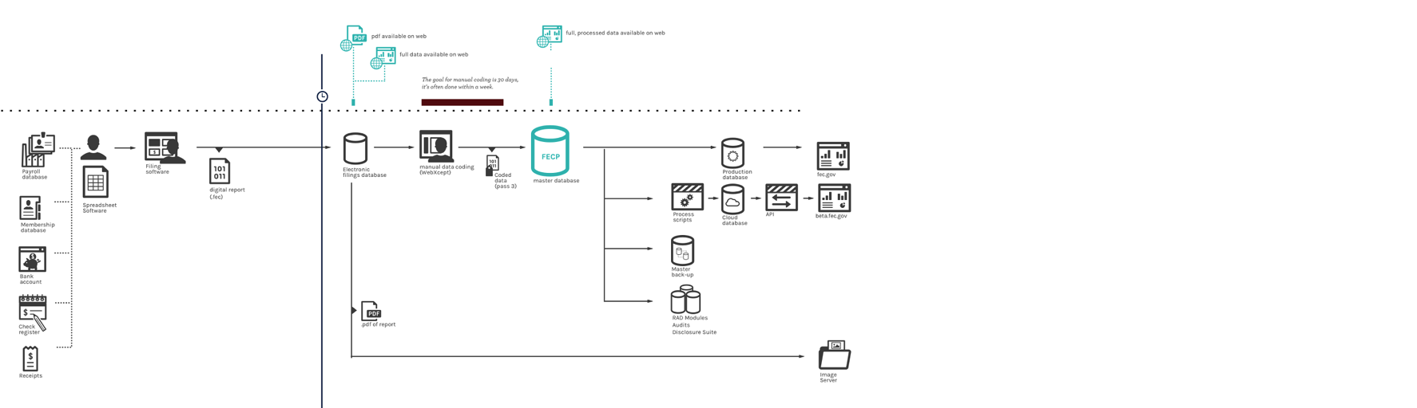
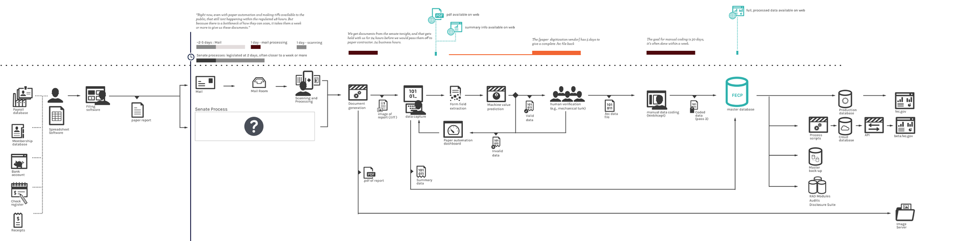
E-Filing (top) versus paper process (bottom)
Notes:
Here are two information flow diagrams that map the data from a filer to a data consumer. The top one maps the e-filing flow, the bottom, the paper process. While it’s too small to make at all the details, note that on the left and right sides, the process is identical.
The difference is the processing that has to happen in the middle, and it’s a sizable difference in processing, which in turn adds considerable delay to when the data is made public. The bottom process adds a week or more to when the data can be released and in complex systems, add potential for error and cost to creep in.
To be clear, this system is huge improvement in terms of time and complexity to the previous system. If we had included the previous paper process at this scale, we’d need to get a bigger room. People appreciate that things are faster.
So the question is: is there anything we can do to speed or improve the process of moving data from the paper to actual machine understood data files?
Spoiler alert: We think there is.

Slide 53
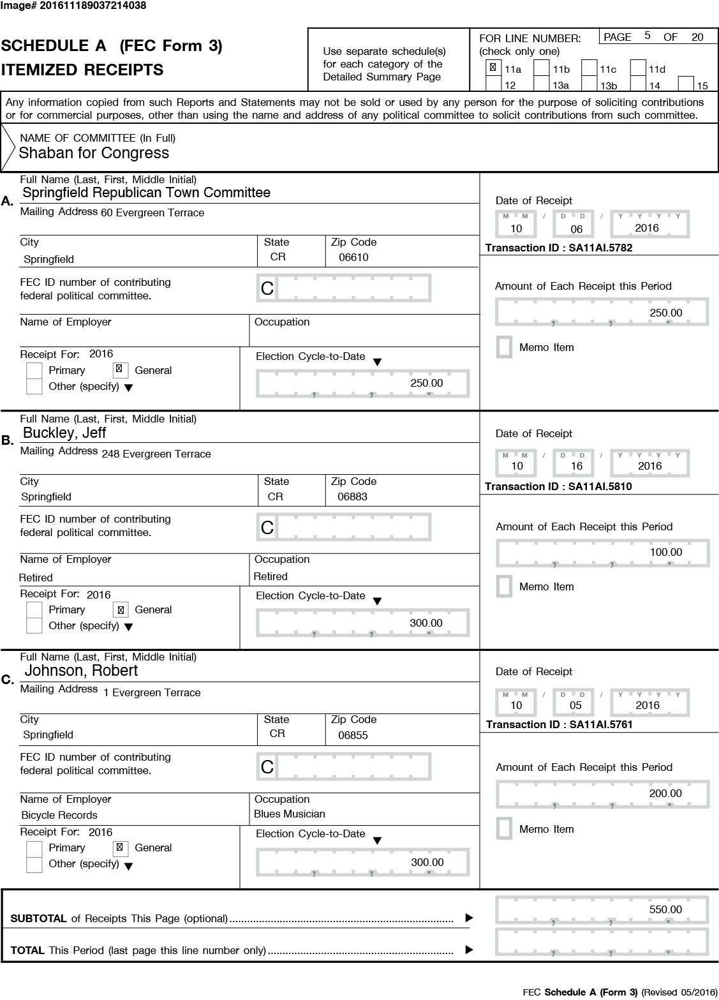
Notes:
Here’s a sample Form 3, Schedule A. This, like most Form 3’s, it was filled out digitally, using software . For paper filers, it goes from digital, to paper, then back to digital, at considerable delay and expense.
The question we wondered was : Could we keep the data digital, even as it takes it’s dog leg through paper? To find out, let’s take a closer look at a specific part of those two process diagrams.

Slide 54
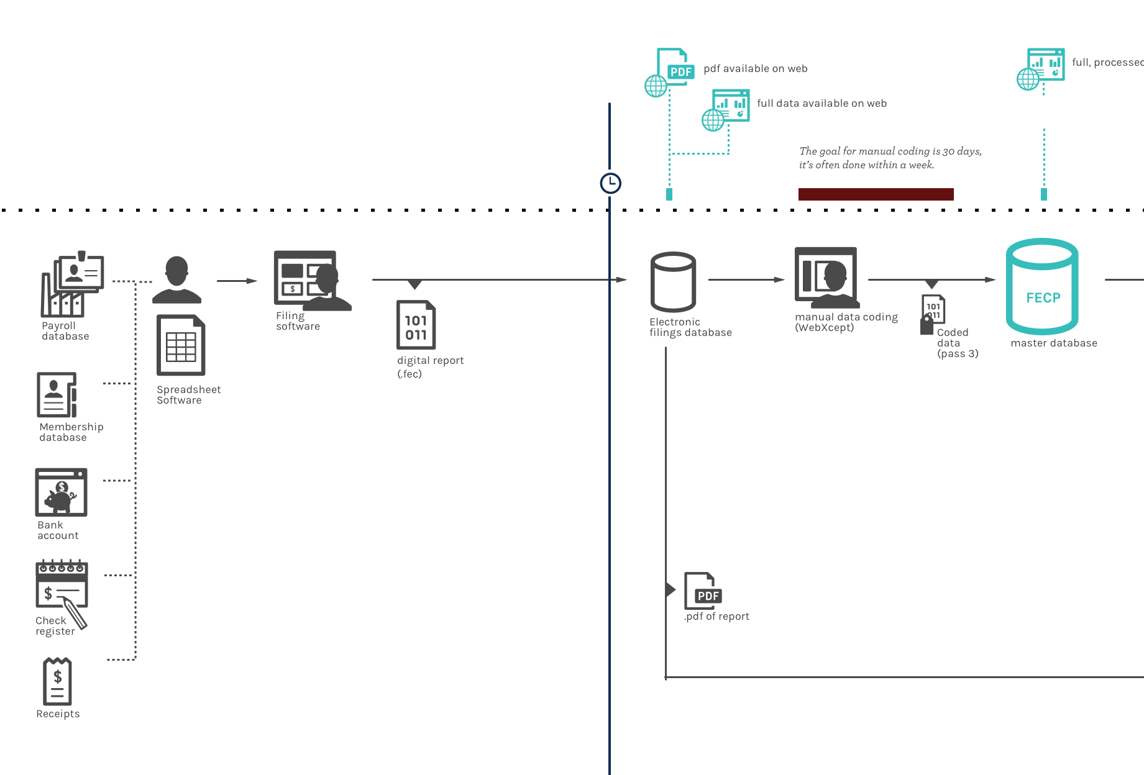
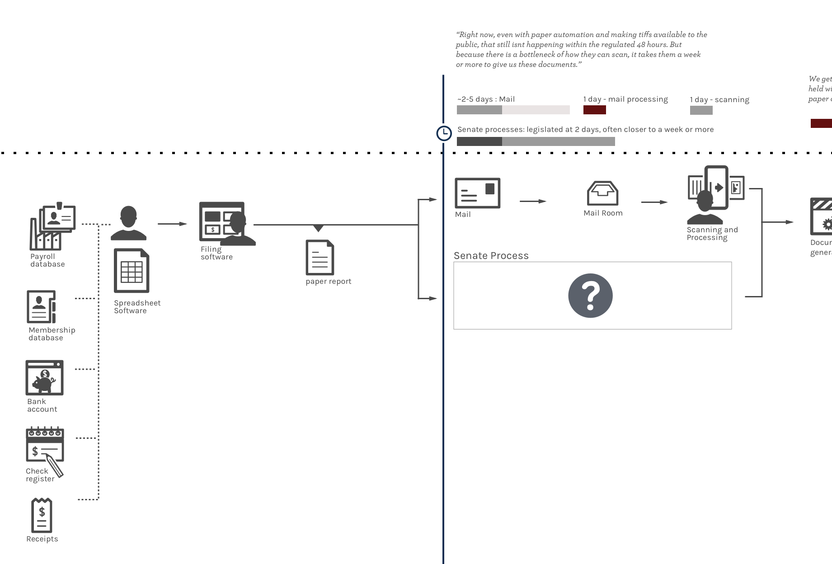
Notes:
Oh interesting! Both the paper filer and the electronic filer are by and large using software to fill out their forms.
In fact, they’re mostly all using the same module to print the form, FECPrint. Curious!
If FECPrint could help us print the data in such a way that machines could later understand it, we’d make it a lot easier on ourselves, more accurate and faster to process.

Slide 55
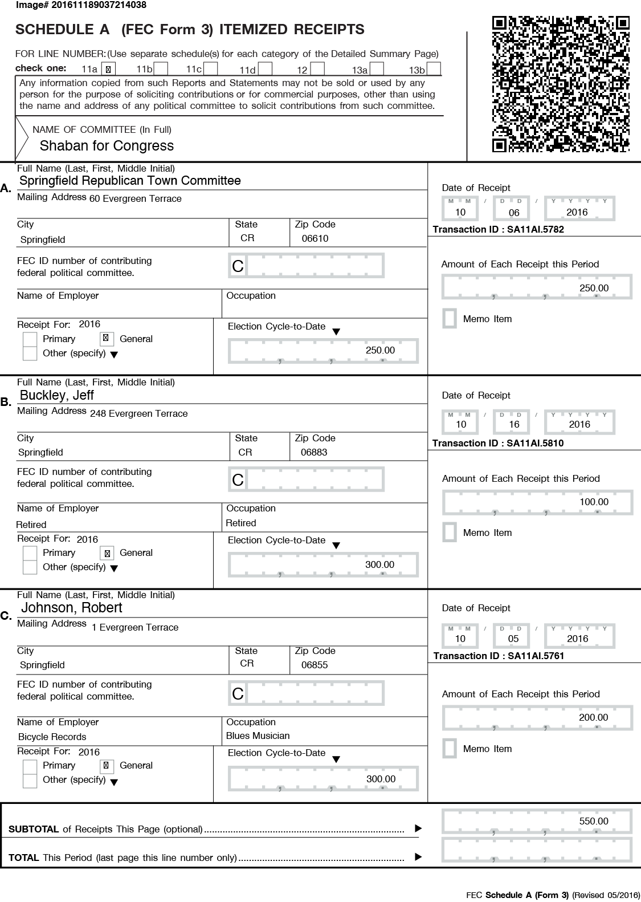
Notes:
Enter the humble QR code.
This is the same Form 3 as shown before, but redesigned to include a 3 dimensional barcode that contains all of the data on that page (this works, try it).
QR codes, those ugly stains on physical advertisements that tried to get us to visit websites we probably never wanted to in the first place has found new life as a useful way for real world processes to keep a toe in the digital one.
Shipping, airlines, and factory processes around the world use these to help keep their physical objects tied to their digital manifestations.
By having FECPrint add these to documents printed for submission, we can make it much easier to scan and accurately collect the data embedded.

Slide 56
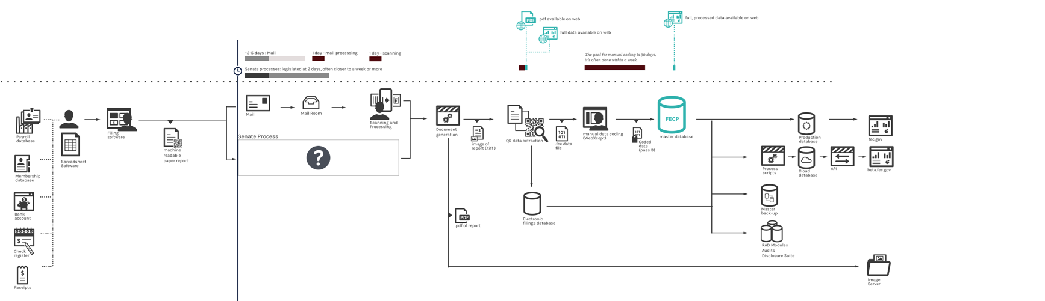
Paper process automation and machine readable process
Notes:
We’re now looking at a comparison of the current paper process (top), with the QR enabled process.
This still won’t approach the speed of e-filing, and will inevitably still have some complexities, but it could prove substantially faster and cheaper than the current paper processing.

Slide 57
To recap:
The data is growing exponentially.
There are data quality issues that make it harder to analyze.
Accelerate the improvements to the filer experience, modernizing intake, and continue moving toward scalable processes
Notes:
The data is growing exponentially. This will pose some challenges
Even small data quality issues make it harder to analyze at this scale
To deal with these challenges we want to
Continue improving the filer experience
Streamline intake paper forms
move toward scalable processes

Slide 58
How to move forward
Notes:
So we’ve talked a lot about the challenges that lay ahead, and what to do about them. Before we let you go, we have a couple notes on where to start, and how to start.

Slide 59
Notes:
18F’s methods aren’t magical-- it’s something the people at FEC are able to implement .
Basically, the best solutions emerge over time,
through experimentation with users
that people, rather than technology, are at the center of our design process.

Slide 60
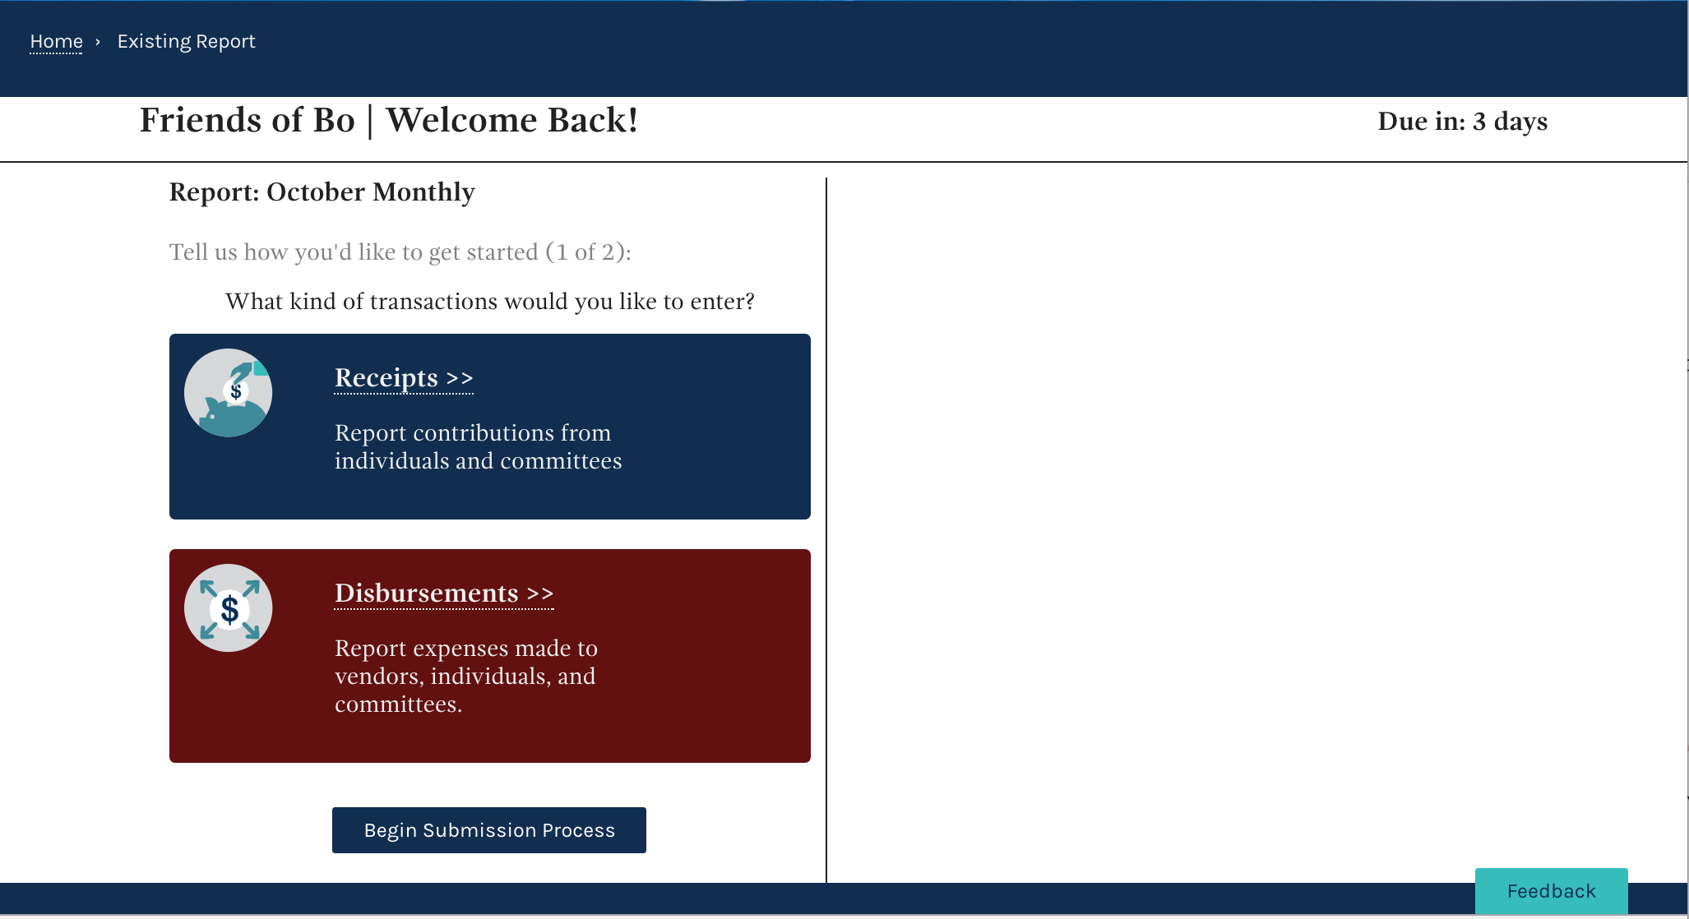
Notes:
For this study we based our filer usability suggestions on prototype that we tested with FEC staff and real filers
That allowed us to learn, build and test what ideas worked and what ideas didn’t
If your interested, we can show you the prototype after the presentation

Slide 61
The FEC has made significant progress toward designing human centered applications.
Notes:
Moreover, the FEC has made significant progress toward designing and implementing human centered applications as part of the beta fec project.

Slide 62
The FEC can expand ongoing efforts to make changes in a human centered, open, and agile way to include designing changes to E-filing.
Notes:
The FEC can expand ongoing efforts to make changes in a
Human centered,
Open
Agile way
...with it’s design and infrastructure changes to efiling.

Slide 63
Thanks, this has been fun! Questions?

Slide 64
Bonus session:
Prototype Show and Tell

Slide 65
Manual entry

Slide 66
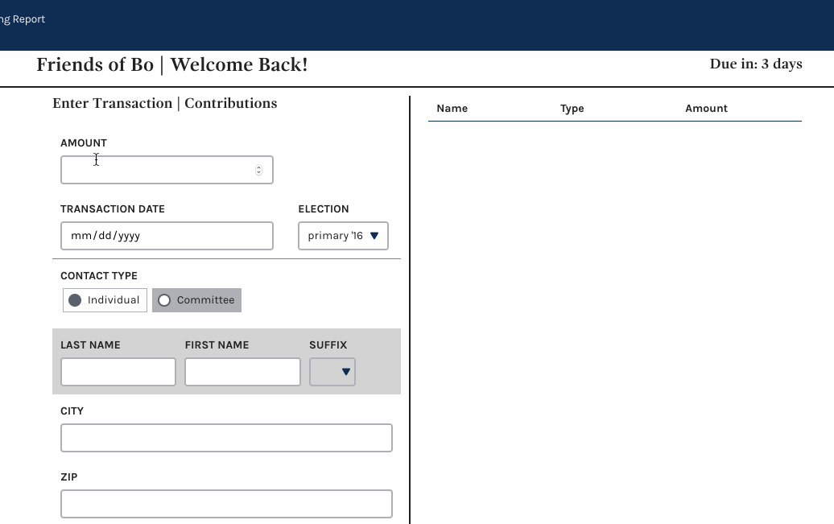
Notes:
https://fec-efiling.apps.cloud.gov/html/enter-receipt.html [fec, fec-rules!]
Two things to watch for in this prototype:
In-line date validation. This didn’t test as well as users were not looking at the screen while entering data
In-line contact look-up. Making the process of entering a name automatically trigger a look-up.

Slide 67
Importing data

Slide 68
One way filers can minimize rekeying errors is by importing their data, yet using the current import feature requires workarounds that are error prone.
Improving FECFile’s usability | One example
Notes:
I want to talk about just one opportunity for improvements to the current FECfile user experience could reduce data entry errors.

Slide 69
“I have to call them every time because I can’t remember how to do this [import file]. I can’t remember. I’ll have to call and have them walk me through it again... I have a good consultant, but he must think I’m the dumbest person in the world because he walks me through."
Notes:
This is a quote from a candidate who files for herself.

Slide 70
IMPORTING PROTOTYPE
We prototyped one possible look and feel, and tested it with users

Slide 71
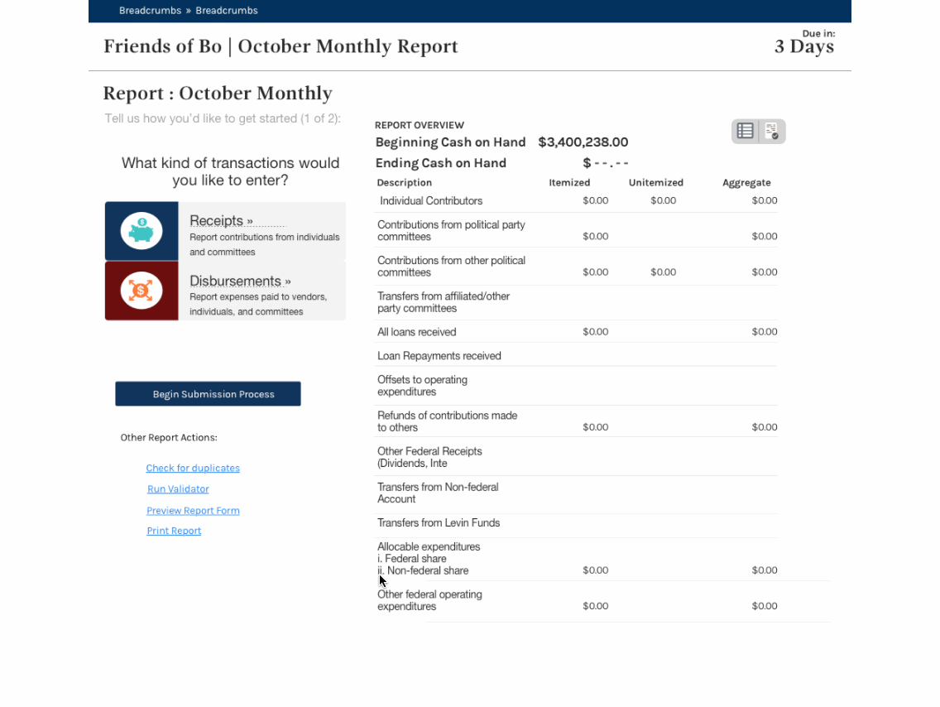
Notes:
Link, not sure how long this one will last:
https://gsa.invisionapp.com/share/AV9DRB29N#/206189682_Getting_Started_-_1-_Choose_Transaction_Type_Copy
Shows an import process that allows users to import the spreadsheet as they have it, attempting to do the mapping automatically.

Slide 72
A lot of our current work is formatting the Excel file. If were able to select from the import file that we have, that would be really great. I would like to be able to select the columns that I need from the spreadsheet.” “That’s nice… I like that very much. So if someone didn't have the spreadsheet in the right order, it would make an attempt to understand what they’ve got. [The current system] takes a phone call to RAD to understand.”
Notes:
While the response was positive, our design is still far from the mark. The FEC can use what we learned through our research and prototyping as a first step in the iterative design and development of an easy to use import feature and promote importing as a mode of data entry.

Slide 73
Merging duplicate contacts
(first attempt)
Notes:
Duplicate contacts are one of the data quality issues that make the data hard to analyze. We uncovered that the process of merging contacts is unclear, and that users created workarounds (for example, adding “Do not use” to the end of a contact name) instead of merging duplicates.
We created a few designs and a prototype to attempt to make the process of merging duplicates easier.

Slide 74
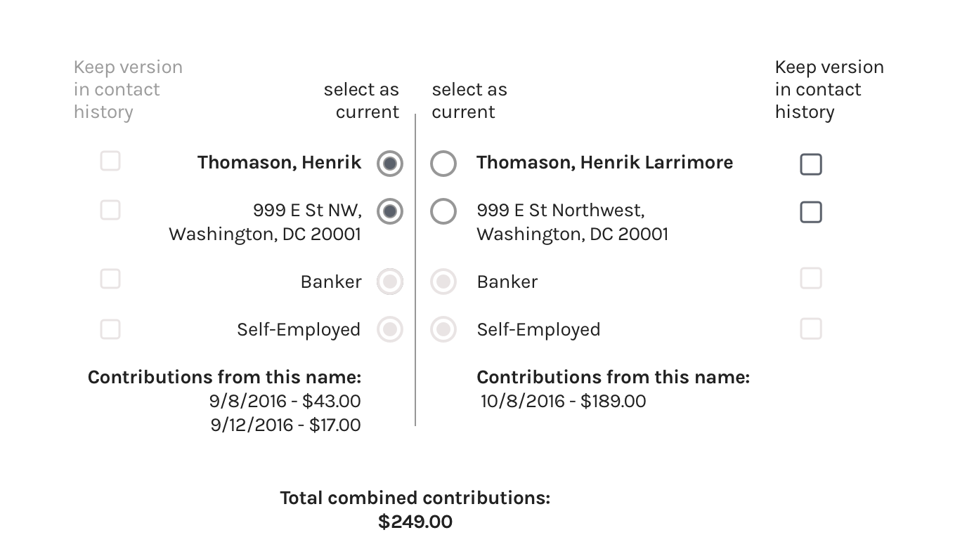
Notes:
This one didn’t survive internal critique.

Slide 75
Merging duplicate contacts
(second attempt)

Slide 76
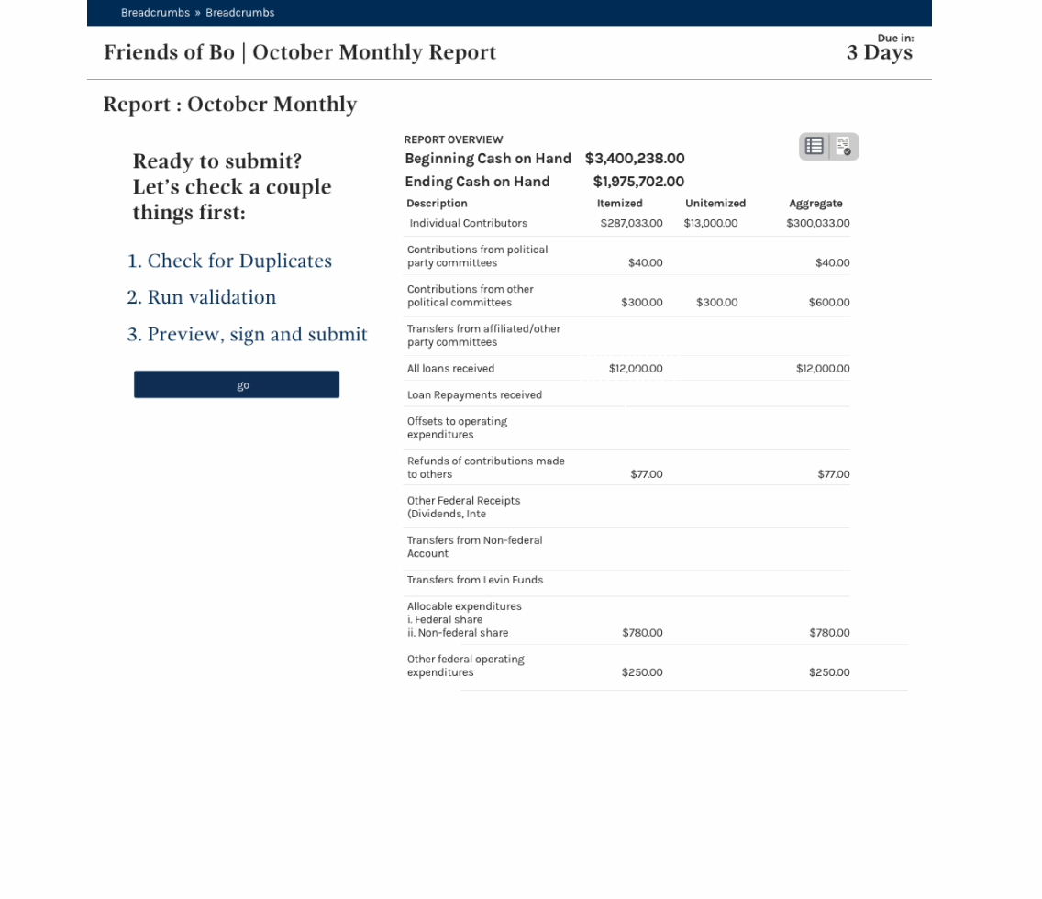
Notes:
Link, not sure how long that will work:
https://gsa.invisionapp.com/share/AV9DRB29N#/207304836_Report_Home_Submit

Slide 77
Merging duplicate contacts
(third attempt)

Slide 78
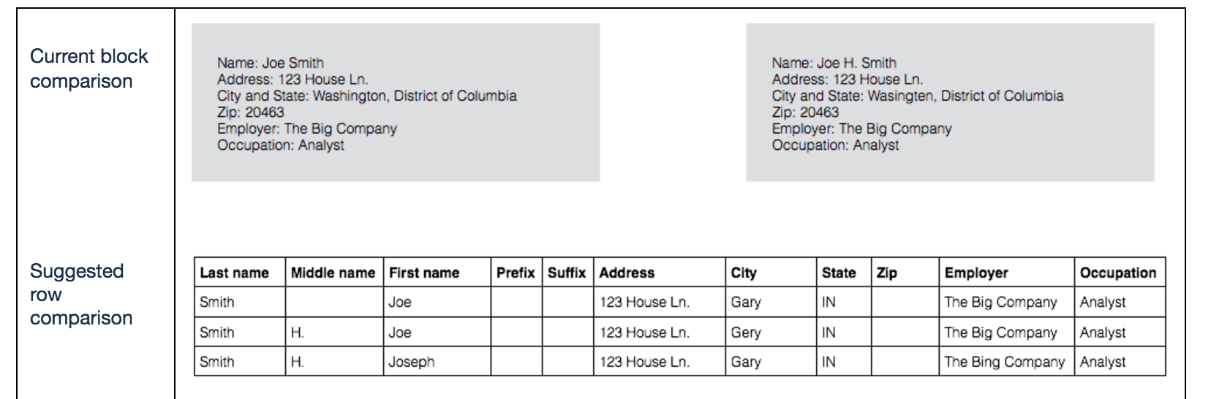
Notes:
This is our last version, but it is by no means the version that should be implemented: we learned in the course of testing version 2 that it’s easier to compare contact values vertically, where differences between them are made more evident (that would be the design principle: make the differences between two contacts as evident as possible).

Slide 79
Thanks!

Slide 80
Back-up slides

Slide 81
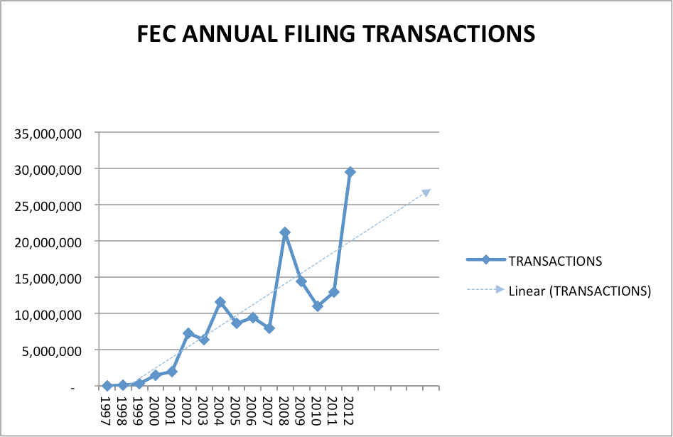
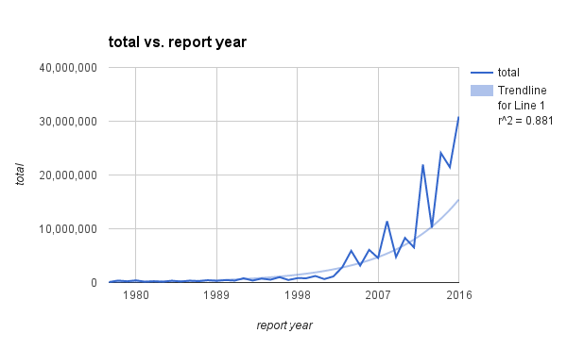
2013 Study Projections
2016 Study Actuals w exponential trend
Notes:
Back-up slide: annual transactions, trends, across studies.
looking by election cycle would likely smooth out these charts.

